Slide 1


Music Recommendation System:
Project Overview
Mohamed Amine Salimi
Khaoula Jellal

Slide 2

CONTENTS
About the project
Our approach
Data collection, preprocessing
Recommendation System Architecture
Recommendation algorithm

Slide 3
ABOUT the project
Song recommendation systems have become an integral part of our music consumption experience. These systems leverage advanced algorithms and data analysis techniques to provide personalized song recommendations to users. By analyzing user preferences, music characteristics, and past listening behavior, these systems offer tailored suggestions that match individual tastes.

Slide 4

approach
Our music recommendation system employs a content-based approach.. We utilize the Euclidean algorithm to measure similarities and identify users or items with similar preferences. This enhances the accuracy of our recommendations and ensures a personalized music discovery experience.
our

Slide 5
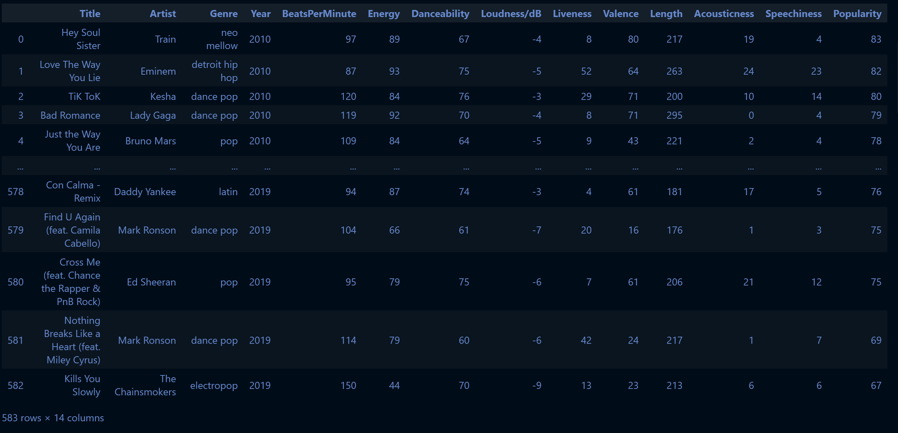
Data Collection and Preprocessing
Data collection:
A comprehensive music dataset was collected from a JSON file.
The dataset encompasses various attributes, including song titles, artists, and genres…
Data Preprocessing(manually):
The pandas library was utilized to import and preprocess the JSON dataset.
A total of 580 songs were extracted from the dataset, ensuring that they were cleaned from missing features…
Each song was represented as an instance of the Song class, encapsulating essential information such as title, artist, genre, and a unique identifier generated through an ID generator function.

Slide 6
Data Collection and Preprocessing
Data collection:
A comprehensive music dataset was collected from a JSON file.
The dataset encompasses various attributes, including song titles, artists, and genres…
Data Preprocessing:
The pandas library was utilized to import and preprocess the JSON dataset.
A total of 580 songs were extracted from the dataset, ensuring that they were cleaned from missing features…
Each song was represented as an instance of the Song class, encapsulating essential information such as title, artist, genre, and a unique identifier generated through an ID generator function.

Slide 7




Our system
Class dynamic array
attributes
methods
Class user
methods
attributes
architecture
class song
attributes
methods

Slide 8
Our system
Class dynamic array
attributes
methods
Class user
methods
attributes
architecture
class song
attributes
methods

Slide 9
Attributes and methods
we utilized the DynamicArray class for efficient and flexible storage of various user-related attributes
append(self, value)
set(self, index, value)
remove(self, index)
__len__(self)
get(self, index)

Slide 10

Our system
Class dynamic array
attributes
methods
Class user
methods
attributes
architecture
class song
attributes
methods

Slide 11
Our system
Class dynamic array
attributes
methods
Class user
methods
attributes
architecture
class song
attributes
methods

Slide 12
Attributes and methods
self.name = name
self.liked_songs = DynamicArray()
self.lisetening_history = {}
self.preferred_genres = DynamicArray()
self.following = DynamicArray()
listen to(self, song_id)
-> None
add_genre(self, genre)
liked_recommendation(
self) -> DynamicArray
add_to_liked_songs(self, song_id: int) -> None
rate_song(self, song_id: int, rate: int) -> None
Notes:
The listen_to function contributes to building the user's listening history, which can later be used as input for the recommendation algorithm.
By keeping track of the user's liked songs and incorporating the user's ratings we can leverage this information to improve the accuracy of the recommendations.

Slide 13

Our system
Class dynamic array
attributes
methods
Class user
methods
attributes
architecture
class song
attributes
methods

Slide 14
Our system
Class dynamic array
attributes
methods
Class user
methods
attributes
architecture
class song
attributes
methods

Slide 15
Attributes and methods
self.name = name
self.liked_songs = DynamicArray()
self.lisetening_history = {}
self.preferred_genres = DynamicArray()
self.following = DynamicArray()
Get_similar_songs(self) -> DynamiArray
Get_same_genre_songs(self) -> None
Get_same_artist_songs(self) -> None
Get_song_id(self)
Notes:
The listen_to function contributes to building the user's listening history, which can later be used as input for the recommendation algorithm.
By keeping track of the user's liked songs and incorporating the user's ratings we can leverage this information to improve the accuracy of the recommendations.

Slide 16
Further information can be found in the docs notebook

